Slide 1
Stock Portfolio
By Prachi Singh
(IMPETUS)

Slide 2
Agenda
Introduction
User Stories
Technology Stack
4+1 View
Data Model

Slide 3
Introduction
What is Stock Portfolio Management ?
StockPortfolio is an online stock portfolio analysis system that gives you and your advisors easy access to your most up-to-date performance figures performance review, current stats anytime you need it, from anywhere in the world. We are like web analytics for investing.
With Portfolio Manager you will have a full control over your virtual portfolio. You will be able to track its performance in real time, manage your assets, get full statistics of your portfolio's performance and its technical indicators.

Slide 4
Agenda of Site
What Stock Portfolio Management offers you?
User can search for a stock by the name of the company or its ticker symbol.
User can see Stock price of the company.
User can add the stock to his portfolio and track it.
User can set alert of a tracked company and if it varies by x% defined. by the user, the user will get an alert on email configured.
User can see the graph of the variation of stock price for a year, a day or selected interval of time for a selected stock.

Slide 5
User Stories
Register
Login
Forgot Password
Search by Ticker Symbol
Track Stocks
View Graph
Update Portfolio
Logout

Slide 6
Technology Stack
Framework | Struts2
Web Server | Apache-tomcat(7.0.29)
Database | MYSQL
Building tool | Apache maven-3.0.4
Unit Testing Tool | JUnit
Logging Tool | Log4j
ORM –Tool | Hibernate

Slide 7
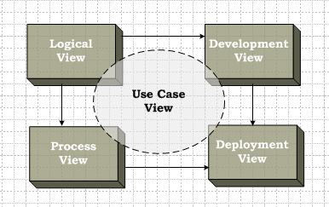
4+1 View

Slide 8
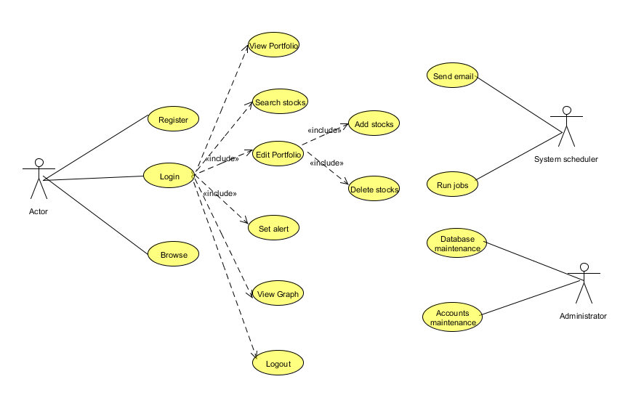
Use Case Diagram

Slide 9
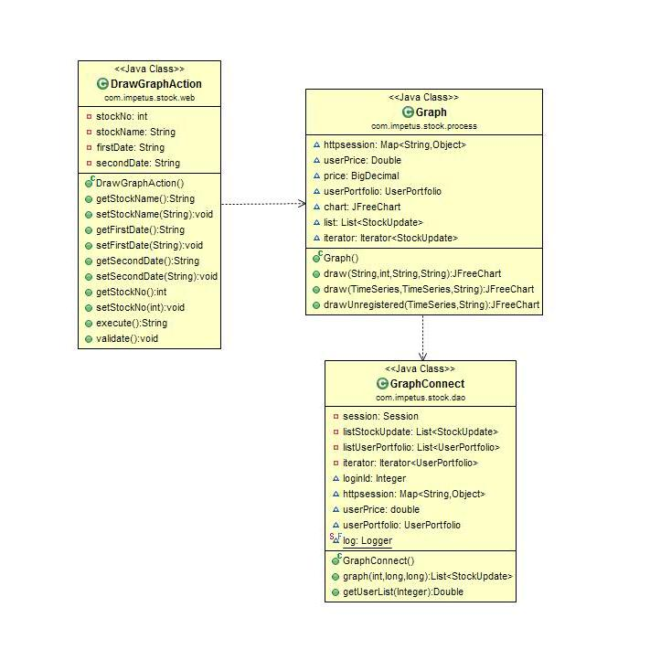
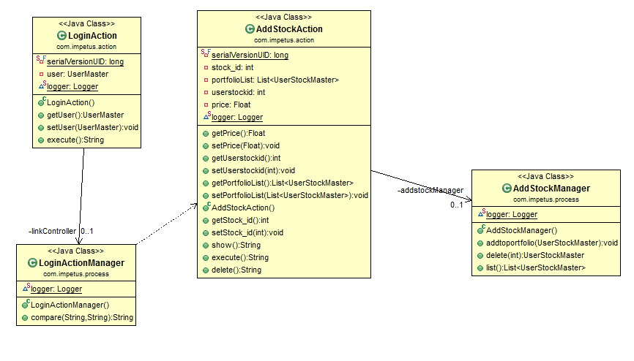
4+1 View: Logical View
Draw Graph Class Diagram

Slide 10
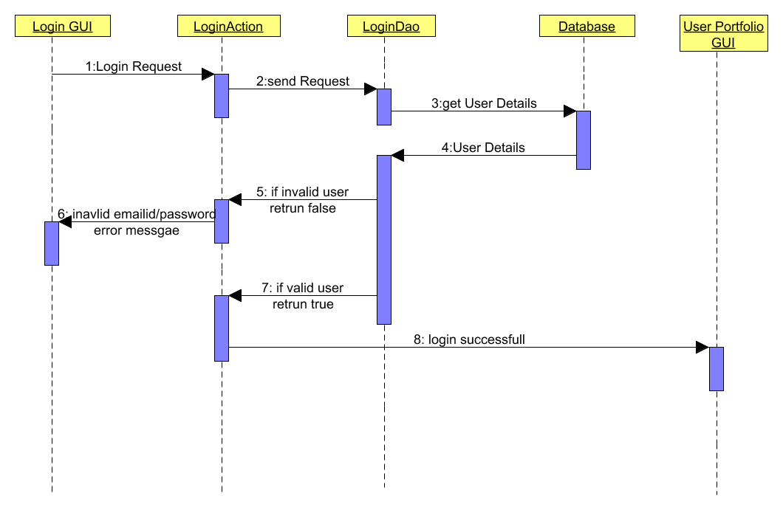
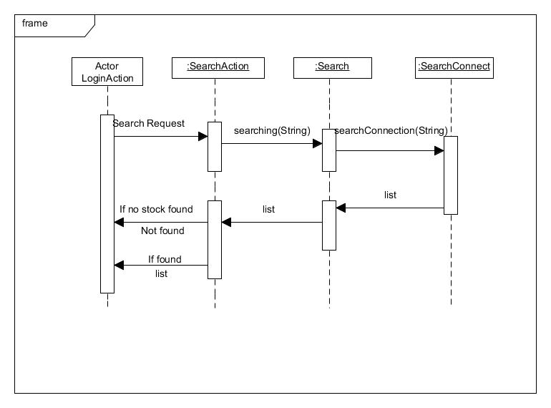
4+1 View: Logical View
Search Stock Sequence Diagram

Slide 11
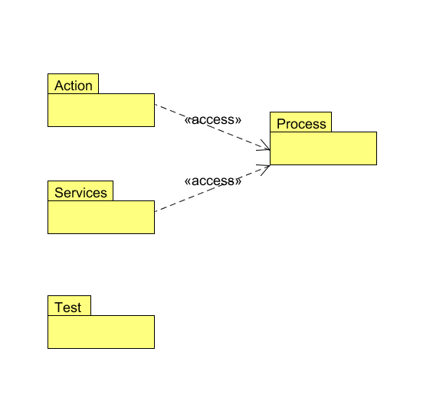
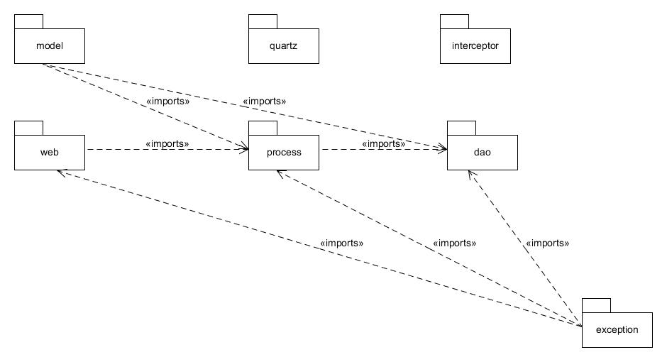
4+1 Views: Development view
Package Diagram

Slide 12
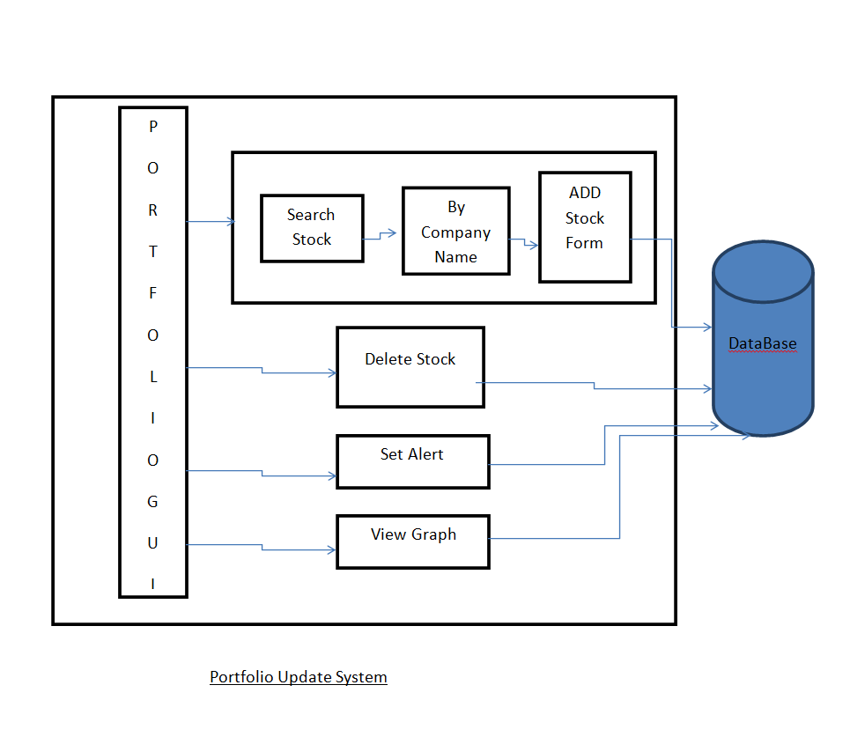
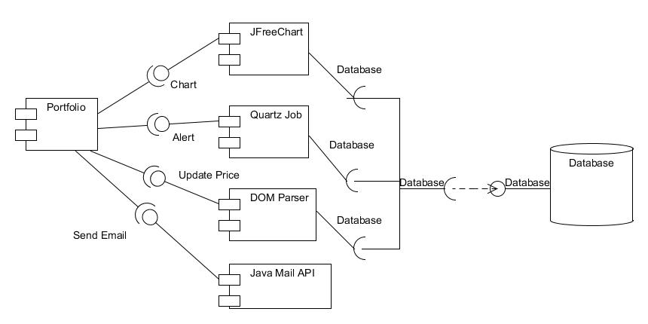
4+1 Views: Development view
Component Diagram

Slide 13
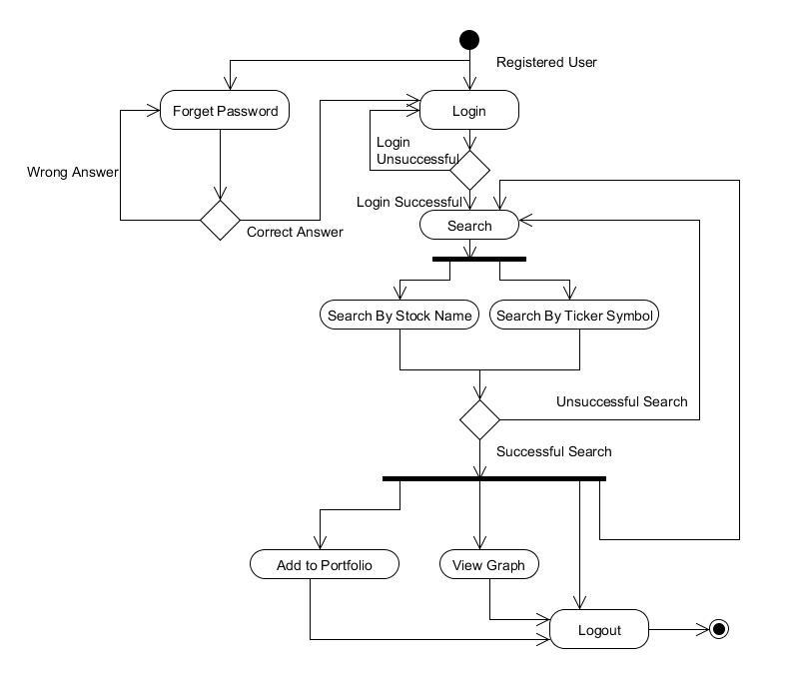
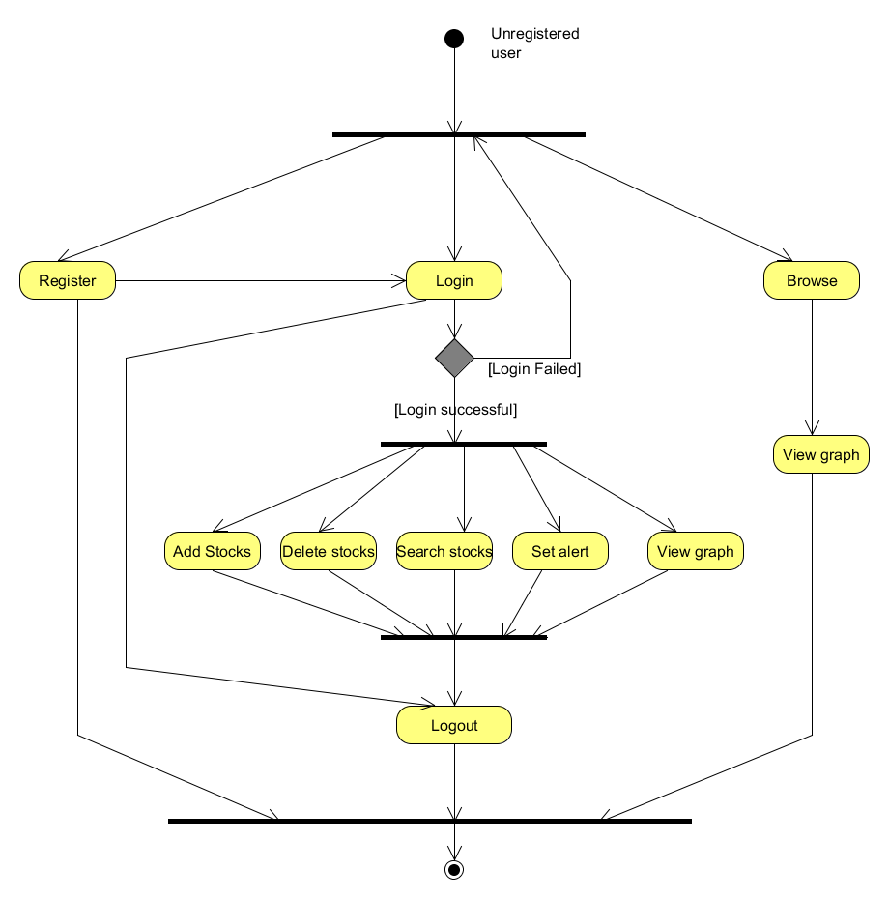
4+1 Views :Process view
Activity Diagram for Registered User(Login & Search)

Slide 14
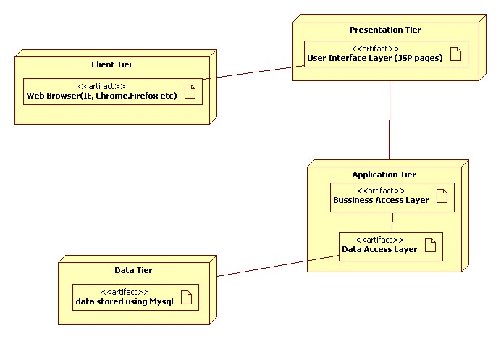
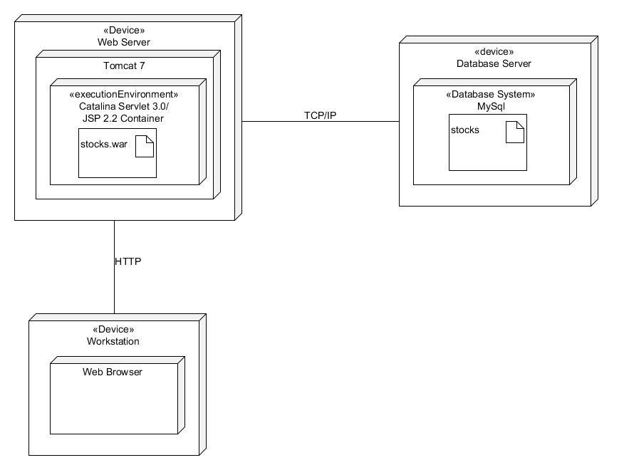
4+1 View: Physical View
Deployment Diagram

Slide 15
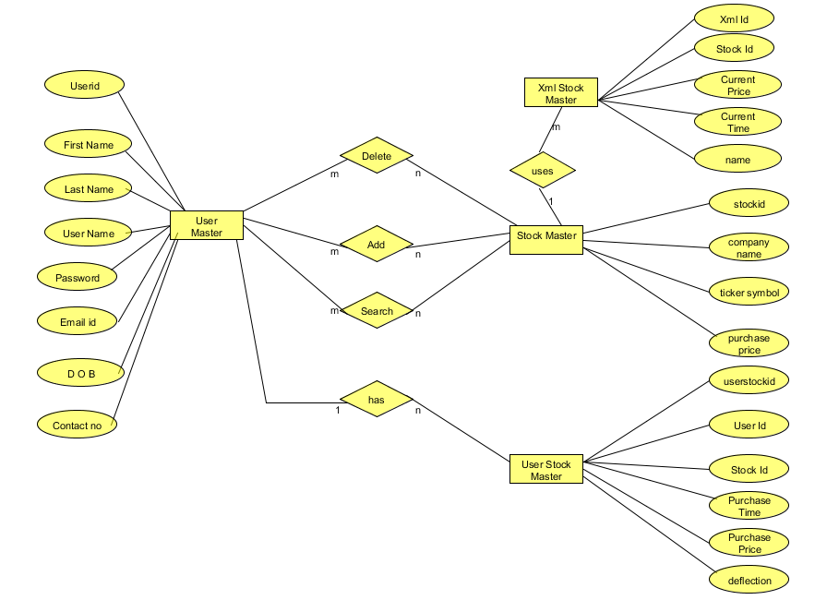
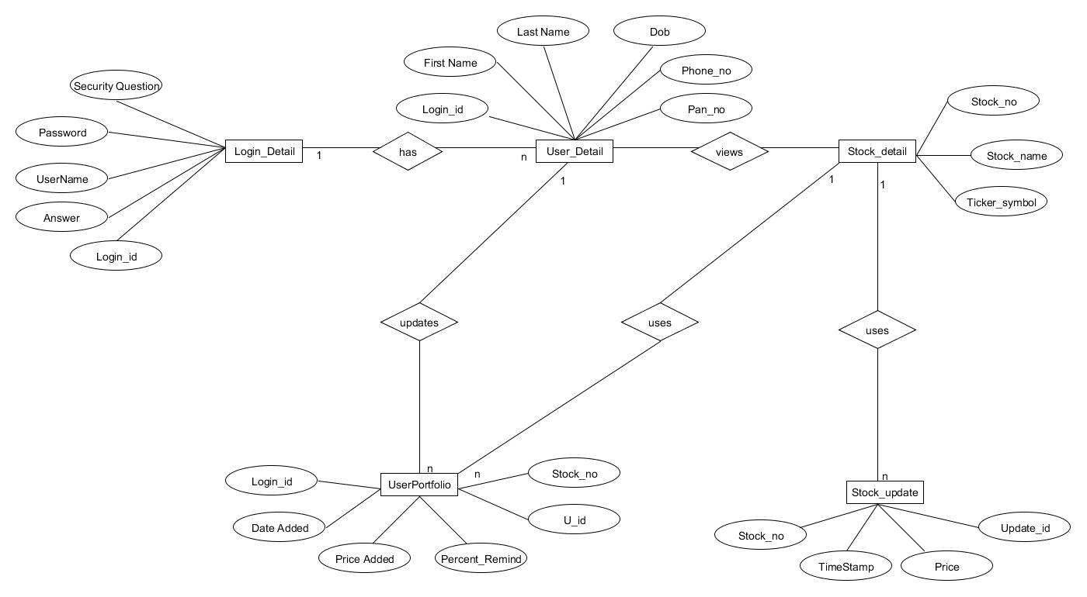
Data Model
ER Diagram
ER Diagram

Slide 16
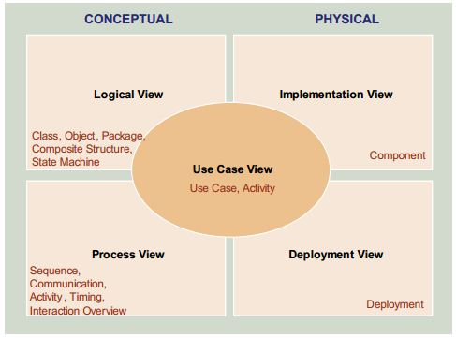

Slide 17
End
THANK YOU

